Slide 1
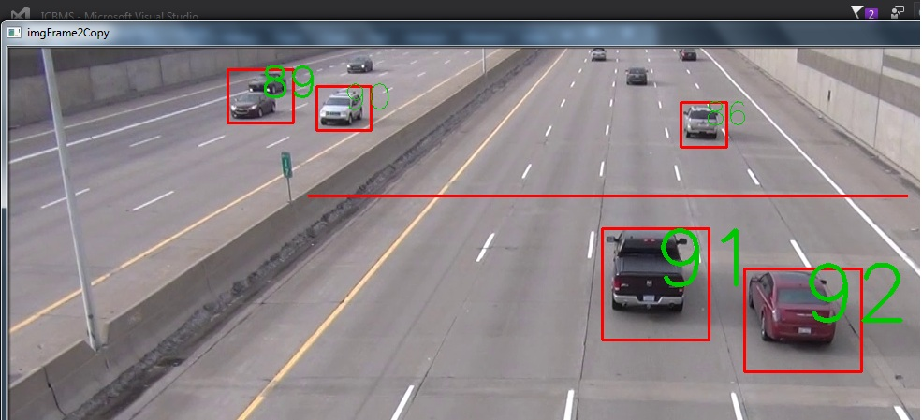
SELF DRIVING CARs PART II
This Photo by Unknown Author is licensed under CC BY-SA

Slide 2
Vehicle DETECTION

Slide 3

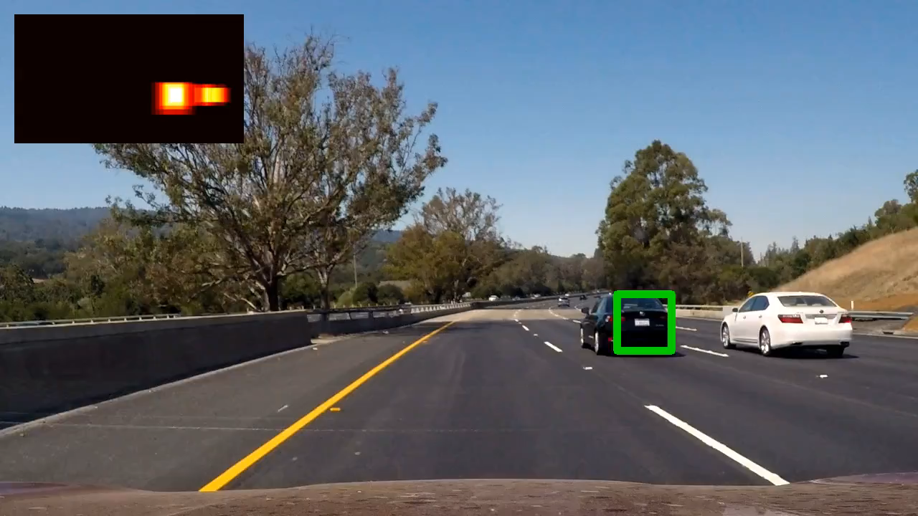
Acknowledgment:
The code for basic lane detection is from Mithi Sevilla. We used this as the foundation to write our tests. The repository can be found at:
https://github.com/mithi/vehicle-tracking-2
Robo-Geek is always grateful to the open source community. Our project is also being shared in reprocity.

Slide 4
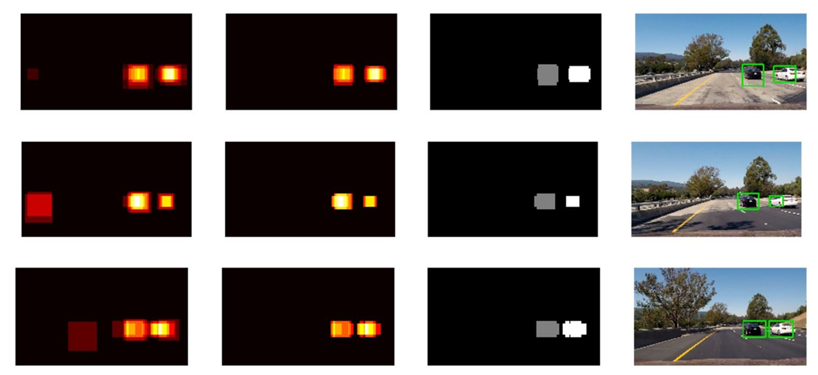
The pipeline
1. Performed a Histogram of Oriented Gradients (HOG) feature extraction on a labeled training set of images
2. Normalized these features and randomized a selection for training and testing a classifier
3. The classifier trained and used for prediction is a Linear SVM classifier. Using a sliding-window algorithm, the trained classifier to search for vehicles in images
4. Created a heatmap of recurring detections frame by frame to reject outliers and follow detected images
5. Estimated a bounding box for vehicles detected
Step 1
Step 2
Step 3
Step 5

Slide 5
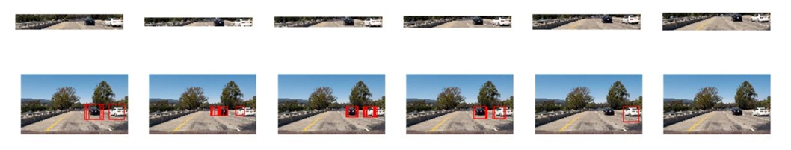
Sliding windows
The method of searching for vehicles in an image is called sliding windows. We can get a sub-region of an image and run that classifier in that region to see if that patch contains a vehicle. Firstly, we have to consider that getting the HOG features is extremely time consuming, so instead of getting the HOG image for each patch region with have many overlaps with each other, we extract hog features of the whole frame of an image and then we subsample that extraction for each sub window of that image.

Slide 6
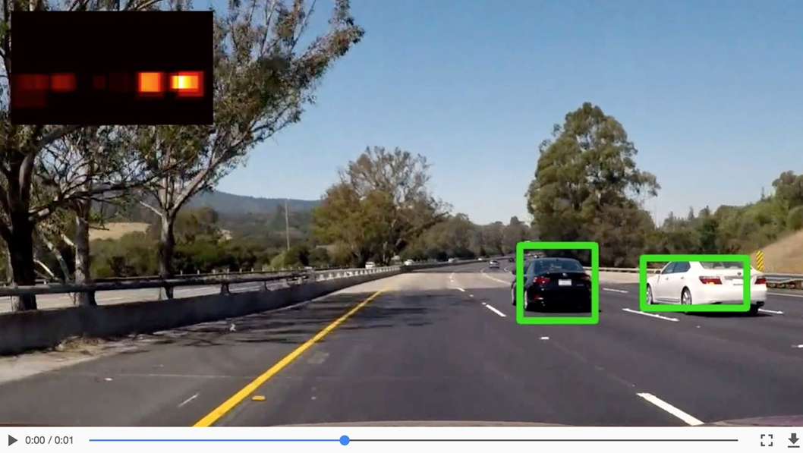
HEATMAP
Given a few consecutive frames, it can be noticed that there are overlapping detections and false positive detections are spaced out. We can build a heatmap to combine overlapping detections and remove false positives. To make a heat map we start with a blank grid and “add heat” (+1) for all pixels within windows where positive detections are reported by the classifier. The “hotter” the parts, the more likely it is a true positive, and we can impose a threshold to reject areas affected by the false positives. We have integrated a heat map over several frames of video. Areas with multiple detections get “hot” while transient false positives stay “cool”.

Slide 7
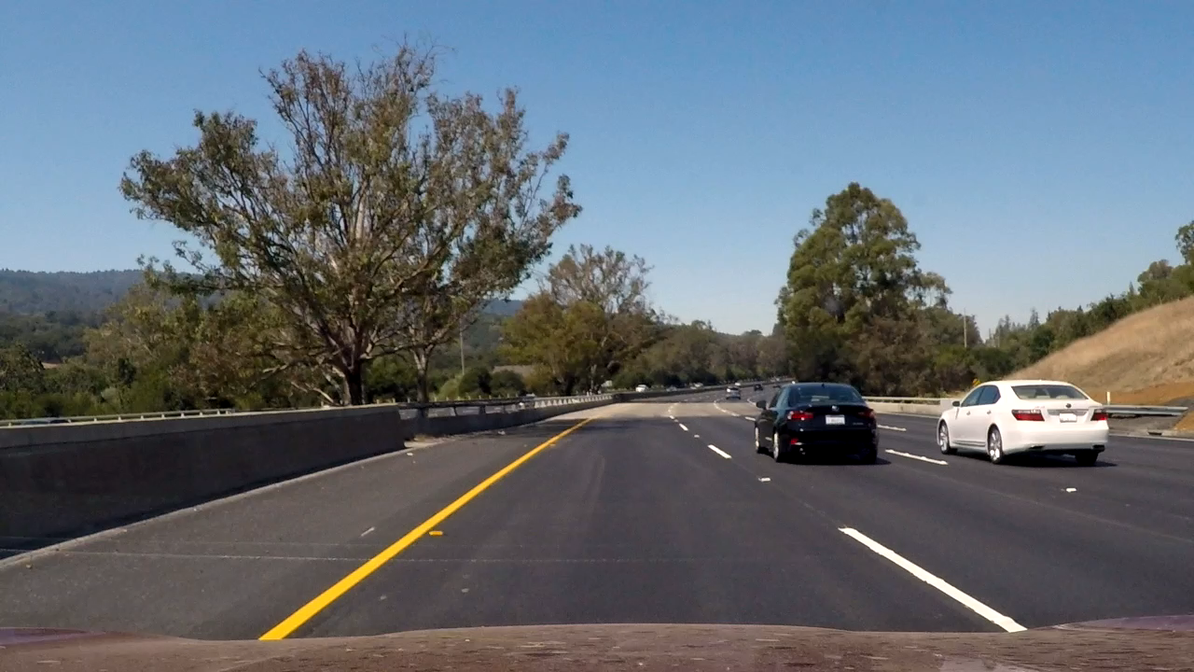

Testing

Slide 8
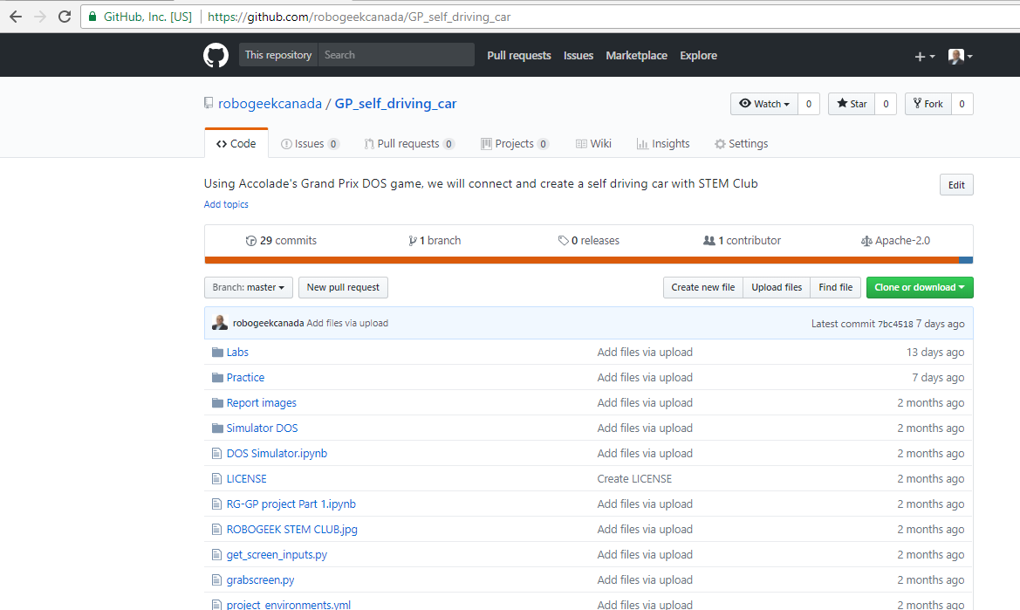
Git-hub
All our code has been shared in GitHub.

